Slide 1
Python lab : Video Submission
Submitted by: Manas Karmkar

Slide 2
AGENDA :-
Understanding the problem statement
Solution approach explanation
Data Structure
Solution evaluation fast and efficient
Python implementation
Conclusion and comments

Slide 3
Understanding problem statement
you are given a list that can contain positive and negative integers. You need to find two elements such that their sum is closest to zero
For example: you are given a list [-4,7,6,2,-5]. The two elements with the sum closest to zero will be -5 and 6
Sample No. | Sample Input | Sample Output
Test case 1 | [-4,7,6,2,-5] | [-5,6]
Test case 2 | [-50,34,-1,24,33,10,-46,-38] | [-38,34]
Hints:
The sum can be either positive or negative but the absolute distance of the sum from zero should be considered to find the sum closed to zero
Assume that the maximum possible sum of any two elements in the list is 1000000000
Inbuilt sort may be helpful in this problem

Slide 4
Solution Approach Explanation
Method 1 – (Simple)
Find the sum of each element with every other element in the list and store it in dictionary. Finally return the minimum sum element from dictionary keys in a sorted tuple.
Algorithm or pseudocode:
Defining a function def closesttozero (list1) with paramenter input list1
Create a empty dictionary which will be used later to store keys as [Elements] : value(sum)
Check list validation if the length of the list is greater than 2 then valid else invalid cannot compute the sum
Initialize two loops until the list’s last elements as length and calculate the sum on each iteration
For each iteration calculated sum selements and absolute sum value need to store in an empty dixtionary
Apply to sort all dictionary items on basis of values which will sort with minimum sum values
Return 1st Key from the dictionary and sort elements within the key also convert them into tuple to get the final output
Auxiliary Space: O(1)
Time complexity : O(n²)

Slide 5
Solution Approach Explanation
Method 2 – (Using Sorting)
Using Quick Sort algorithm
Algorithm or pseudocode:
Sort all the elements of the input list (input_list) using the Quick sort algorithm
Use two index variables l and r to traverse from the left and right ends respectively
Initialize l as 0 and r as n-l where n is length of input_list
Sum = input_list[l] + input_list[r]
If sum is –ve then l=i+1
If sum is +ve then r=r-1
Keep track of abs min-sum
Repeat steps 3,4,5 and 6 while l<r
Auxiliary Space: O(1)
Time complexity : Complexity to sort + complexity of finding the optimum pair = O(nlogn) + O(n) = O(nlogn)

Slide 6
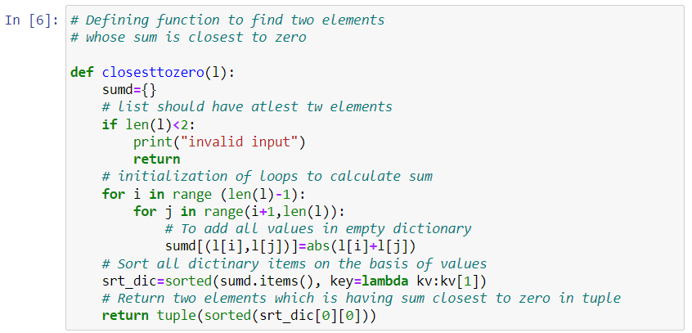
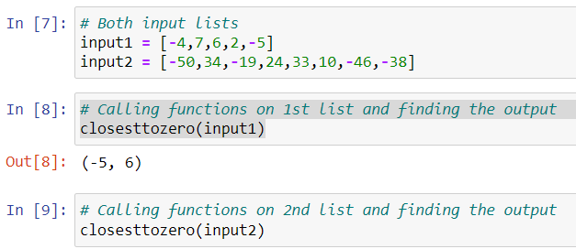
Python Implementation: Coding
Method 1 - Code
Python data structure used :
List
Dictionary
Tuple
Method 1 - Outputs

Slide 7
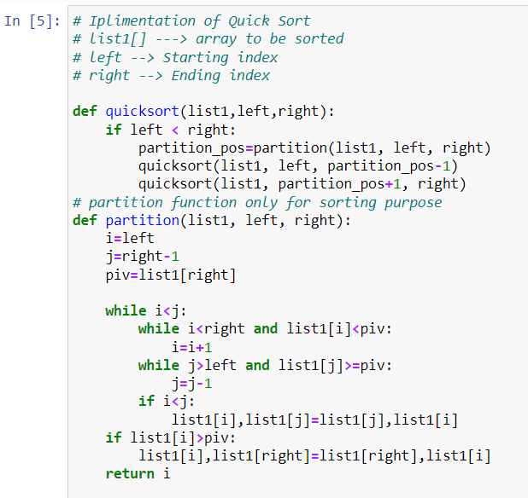
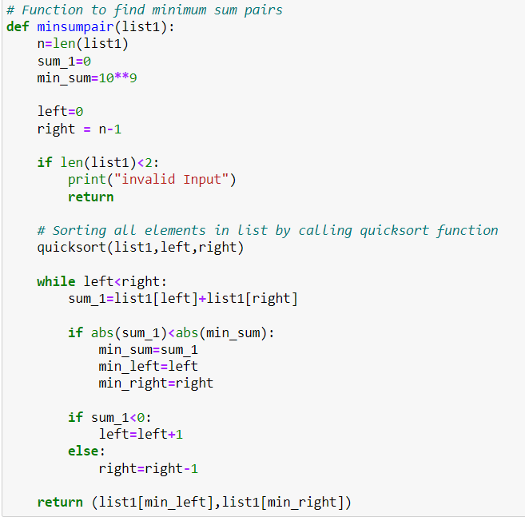
Python Implementation: Coding
Method 2 - Code

Slide 8
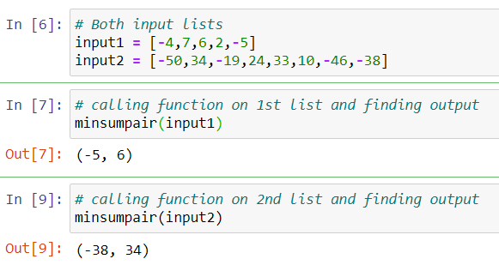
Python Implementation: Coding
Method 2 - Outputs

Slide 9
Python Implementation: Coding
Both methods are working fine and the outputs are matching as expected
There are other ways we can solve the problem
Video recording explanation is uploaded in below path

Slide 10
Thank You

